Slide 1
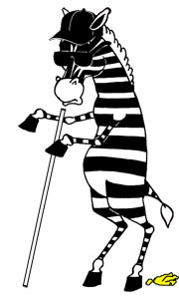
What a Successful Official Looks Like

Slide 2
1. Words and Actions must Match
Walk the talk – Be fair
Contact school administration – lateness destroys creditability
Be well dressed – uniform not wrinkled
Hold your pre-meet with coaches and teams, should be no longer than 5 minutes
Preventative Officiating
Handle conflicts in professional manner

Slide 3
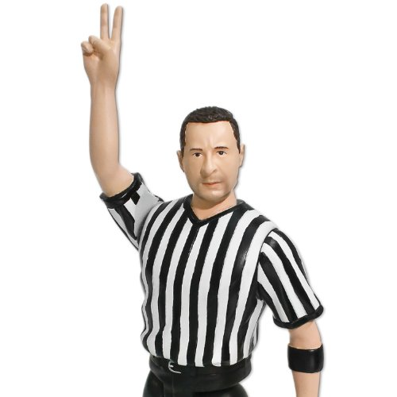
2. Be an Assignor’s Official
Keep Calendar Updated
Accept Assignments – every match is a big match to someone
One and off mat professionalism – not saying something that could get you in trouble
Do not go looking for trouble

Slide 4
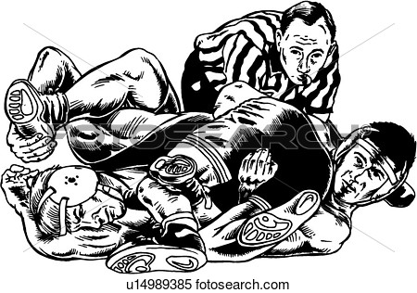
3. Humble Spirit
Check Ego
Not bigger than the game
Calm Demeanor when addressing coaches
4. Communicate and treat with respect your team of scorers, timers, tappers, and book keepers

Slide 5
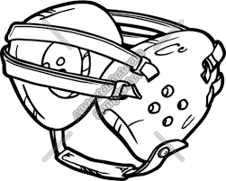
4. Be the Official Everyone Wants to Work With
Professionalism
Never sell out your partner
Handle difficult situations with class and dignity

Slide 6
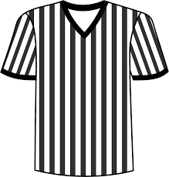
5. Be an Ambassador for Wrestling and Pass on Your Knowledge
Pass on your knowledge to an eager new official
Help recruit new officials
Hold yourself to high standard – could be first time someone has seen a wrestling match and official

Slide 7
Job Description

